Slide 1
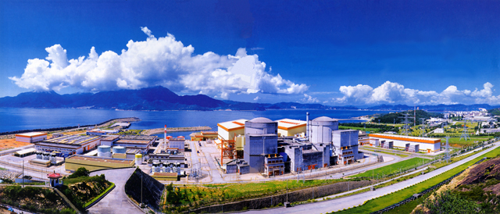
Latest results from Daya Bay
Wenqiang Gu
Brookhaven National Laboratory
On behalf of the Daya Bay Collaboration

Slide 2
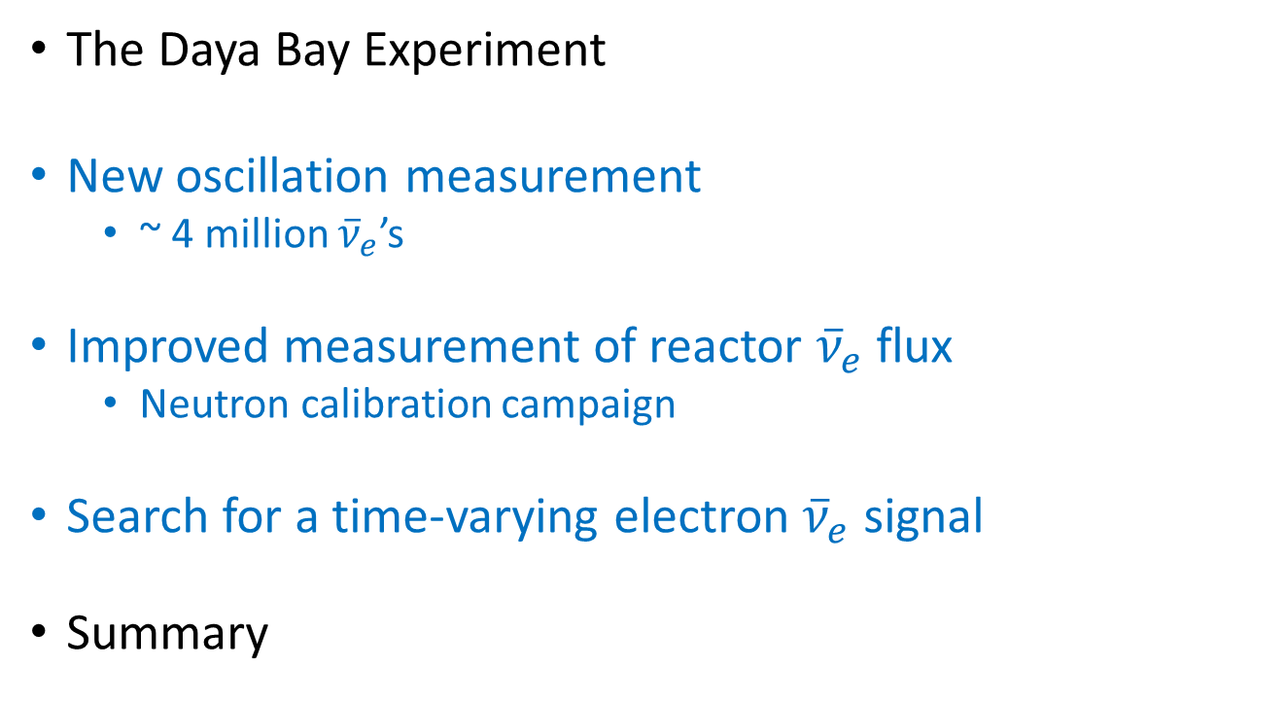
Outline
The Daya Bay Experiment
New oscillation measurement
~ 4 million ${\overline{ν}}_{e}$’s
Improved measurement of reactor ${\overline{ν}}_{e}$ flux
Neutron calibration campaign
Search for a time-varying electron ${\overline{ν}}_{e}$ signal
Summary

Slide 3
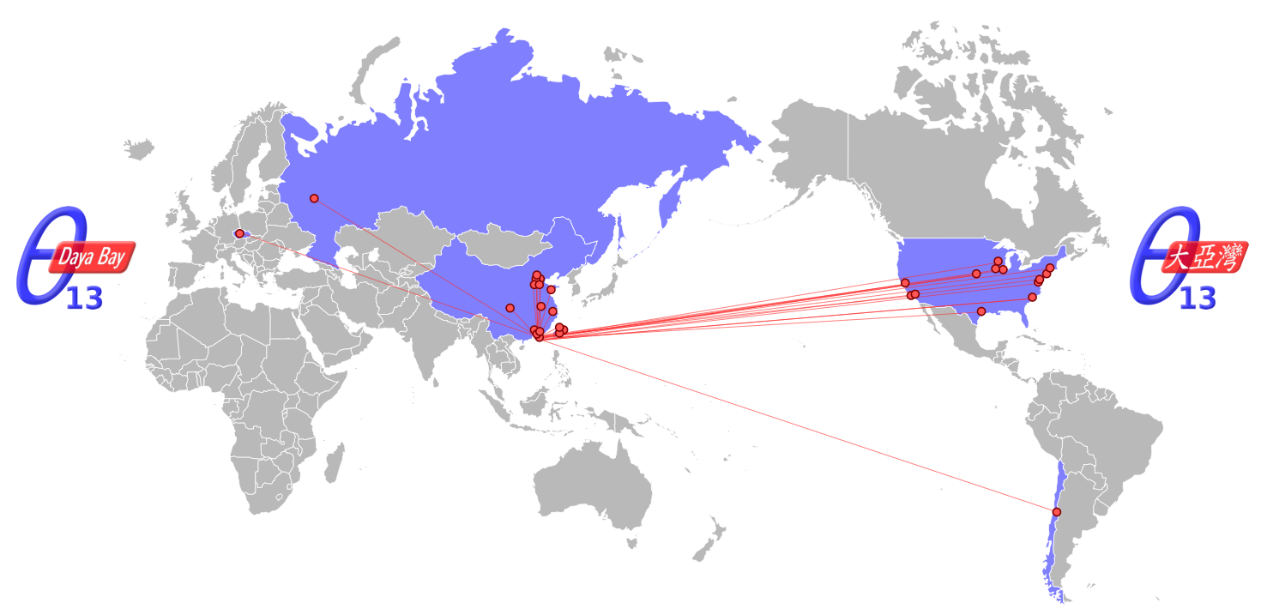
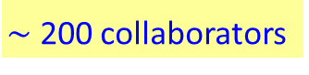
The Daya Bay Collaboration
$\sim$ 200 collaborators
Asia (23)
Beijing Normal Univ., CGNPG, CIAE, Chongqing Univ., Dongguan Univ. Tech., ECUST, IHEP, Nanjing Univ., Nankai Univ., NCEPU, NUDT, Shandong Univ., Shanghai Jiao Tong Univ., Shenzhen Univ., Tsinghua Univ., USTC, Xian Jiaotong Univ., Zhongshan Univ.,
Chinese Univ. of Hong Kong, Univ. of Hong Kong,
National Chiao Tung Univ., National Taiwan Univ., National United Univ.
North America (15)
Brookhaven Natl Lab, Illinois Institute of Technology, Iowa State, Lawrence Berkeley Natl Lab, Princeton, Siena College, Temple University, UC Berkeley, Univ. of Cincinnati, Univ. of Houston, UIUC, Univ. of Wisconsin, Virginia Tech, William & Mary, Yale
South America (1)
Catholic University of Chile
Europe (2)
Charles University, JINR Dubna

Slide 4
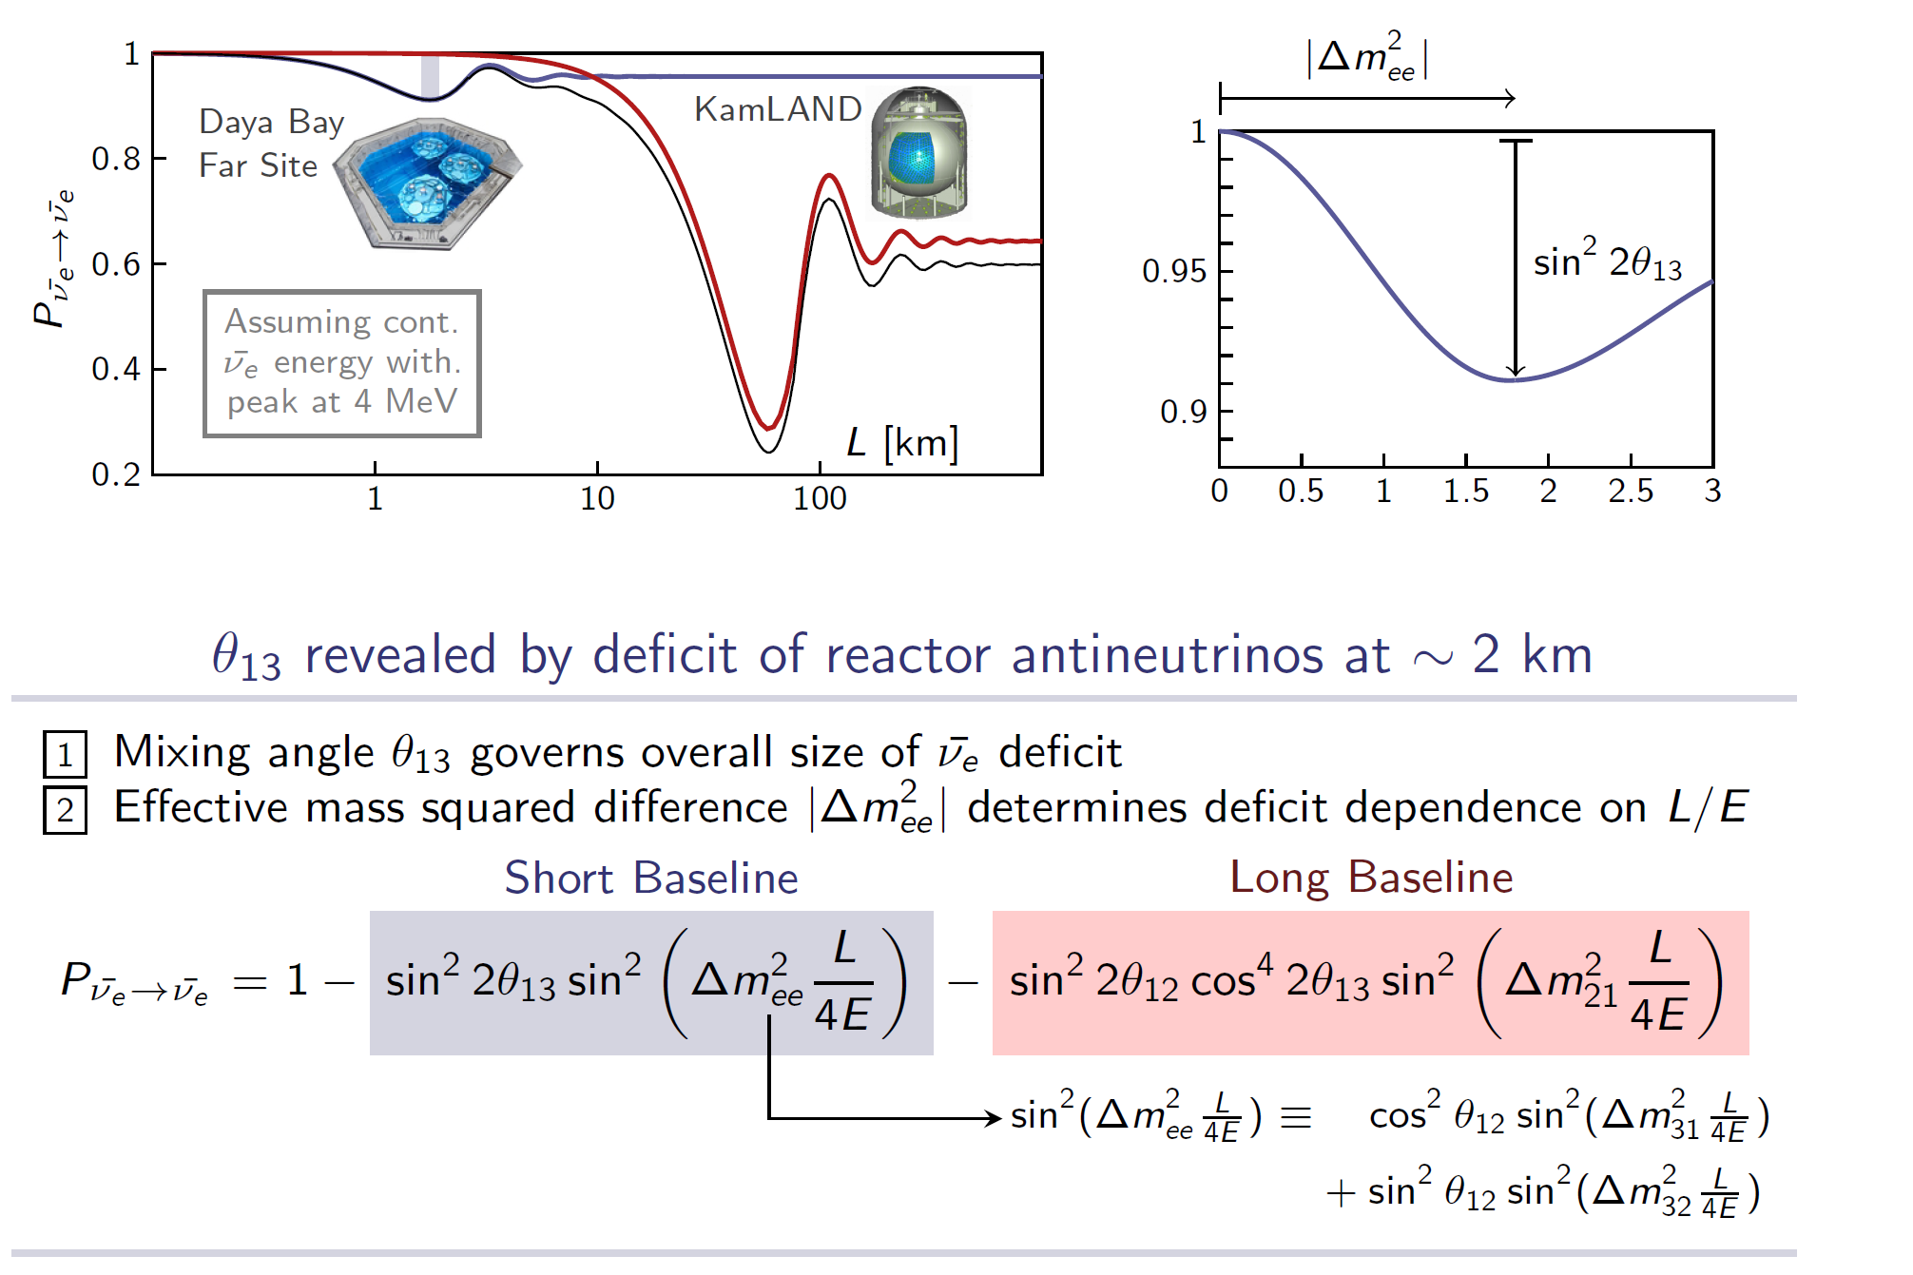
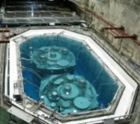
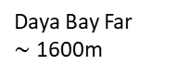
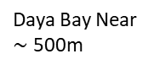
Reactor Neutrino Oscillation
$$P_{{\overline{ν}}_{e}→{\overline{ν}}_{e}}≈1−\sin^{2}2θ_{13}\sin^{2}Δm_{ee}^{2}\frac{L}{4E}−\cos^{4}θ_{13}\sin^{2}{2θ}_{12}\sin^{2}Δm_{21}^{2}\frac{L}{4E}$$
Keys to a precise measurement
High-statistics
Suppressing backgrounds
Systematics control
Daya Bay Near
$\sim$ 500m
Daya Bay Far
$\sim$ 1600m
JUNO
Relative measurement with 8 functionally identical detectors
Absolute neutrino flux: significant uncertainty in previous experiments (e.g., Chooz)

Slide 5
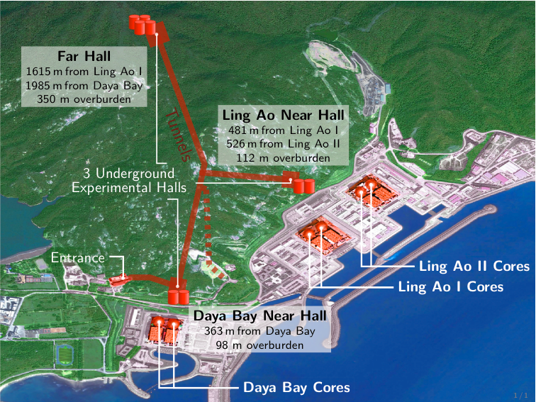
Daya Bay Experimental Layout
Eight identically designed detectors
Six 2.9GW_{th} reactors
~ 95% cancellation in (uncorrelated) reactor uncertainty with optimized baselines
Far Hall (EH3)
1540 m from Ling Ao I
1912 m from Daya Bay
860 m.w.e overburden
(EH3)
Ling Ao Near Hall (EH2)
480 m from Ling Ao I
528 m from Ling Ao II
265 m.w.e overburden
Daya Bay Near Hall (EH1)
364 m from Daya Bay
250 m.w.e overburden

Slide 6
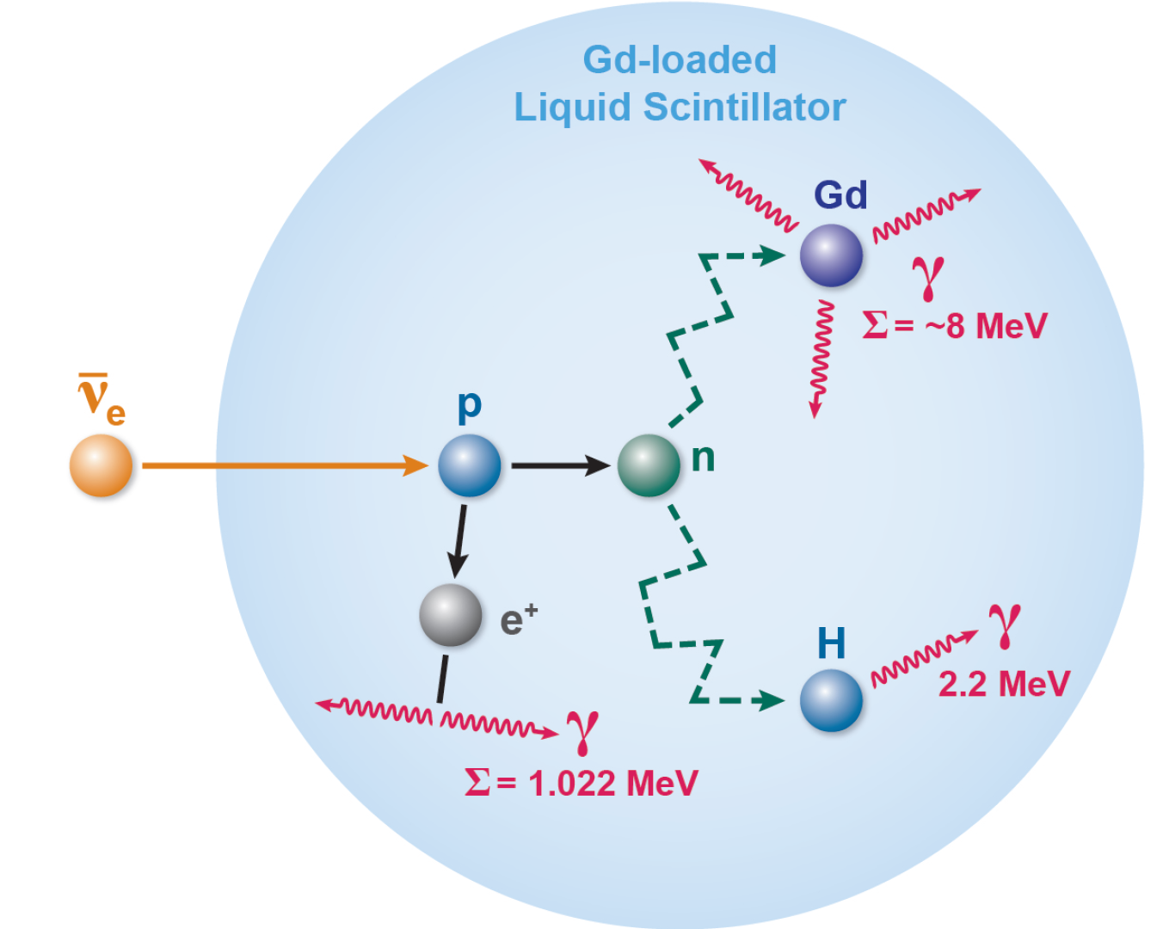
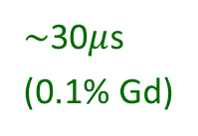
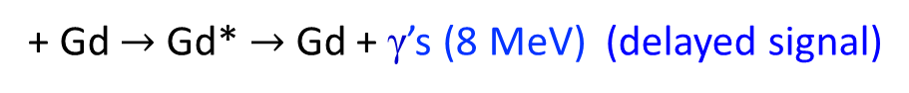
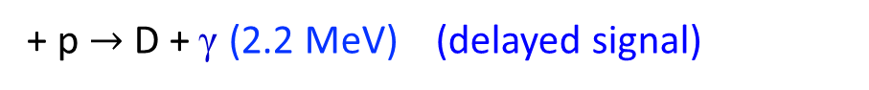
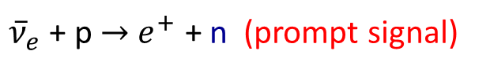
Antineutrino Detection
Inverse β-decay (IBD): coincidence of two consecutive signals
${\overline{ν}}_{e}$ + p $→$ $e^{+}$ + n (prompt signal)
$∼$30$μ$s
(0.1% Gd)
+ p $→$ D + γ (2.2 MeV) (delayed signal)
+ Gd $→$ Gd* $→$ Gd + γ’s (8 MeV) (delayed signal)
Powerful background rejection
Positron preserves most information about antineutrino energy

Slide 7
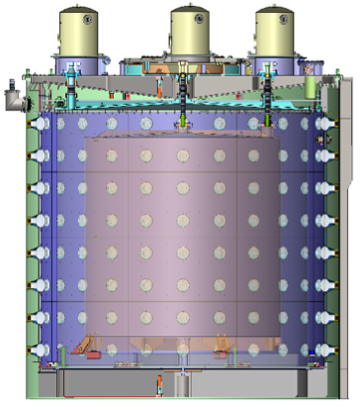
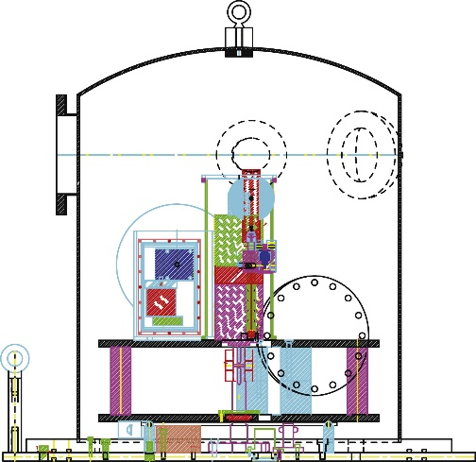
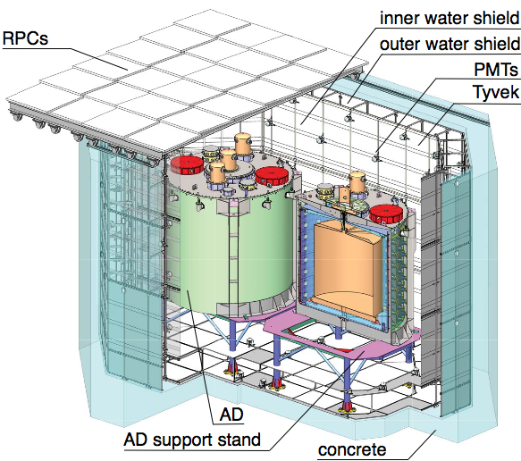
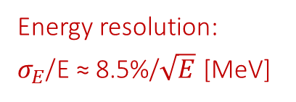
Daya Bay Detectors
The antineutrino detectors (ADs) are “three-zone” cylindrical modules immersed in water pools
Automated calibration unit (ACU)
NIM A750, 19-37 (2014)
Gd-doped Liquid Scintillator (LS)
LS
192 8” PMTs
Mineral Oil
source deployment
Energy resolution:
$σ_{E}$/E ≈ 8.5%/$\sqrt{E}$ [MeV]
Water pool: shield the ADs and veto cosmic-rays
NIM A 811, 133 (2016)
NIM A 773, 8 (2015)

Slide 8
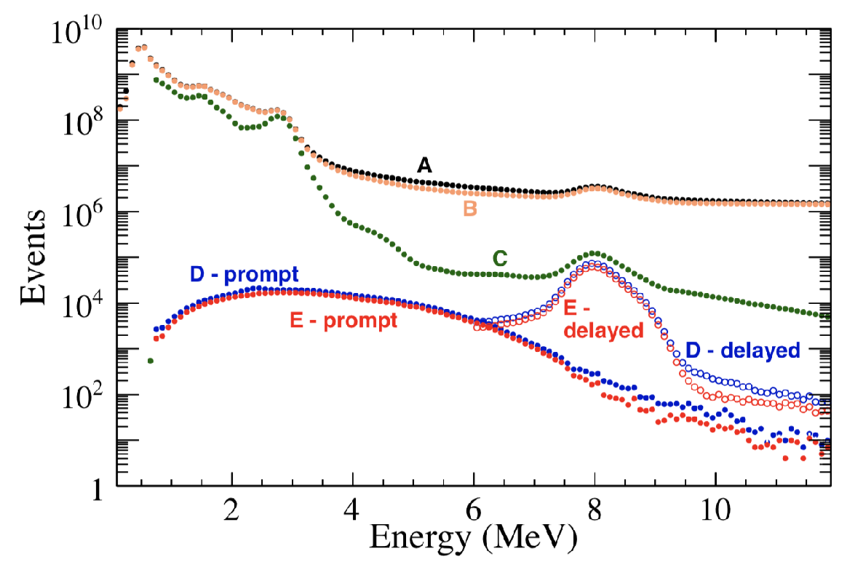
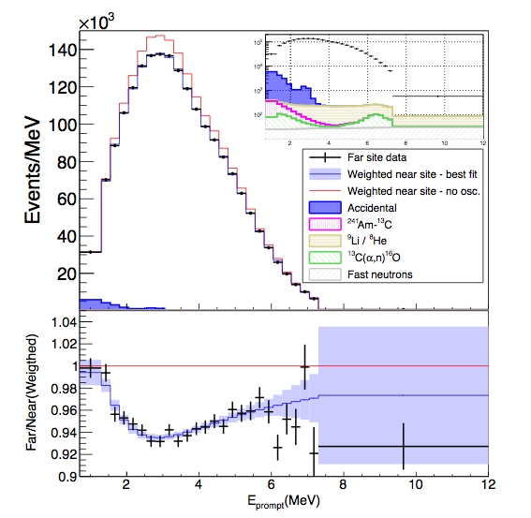
IBD Selection
New oscillation result with 1958 days of data
Dec 24, 2011 to Aug 30, 2017
(A) All signals;
(B) PMT flasher removal;
(C) Water pool muon veto;
(D) Coincidence pair; (E) AD muon veto
< 2% background in all halls
Roughly 60% increase in statistics with respect to previous result
Other important improvements (see next slides)

Slide 9
New Dataset
Some highlights of the new 1958-day dataset
~ 4 million antineutrino interactions (0.5 million at far site)
Statistical error in ${\overline{ν}}_{e}$ rates: ~0.11% (near ADs), ~0.29% (far ADs)
Background uncertainty in ${\overline{ν}}_{e}$ rates: ~0.12% (all ADs)

Slide 10

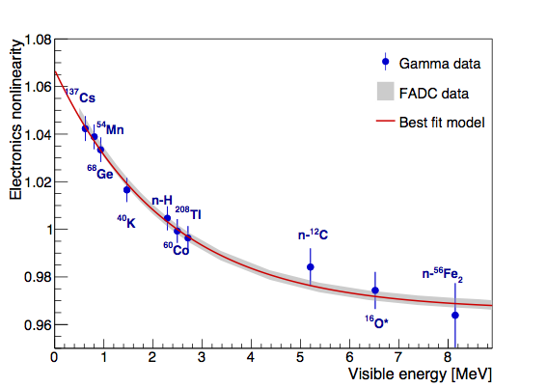
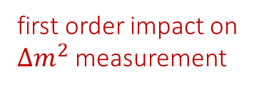
Improved Energy Response Model
Energy model: reconstructed positron energy to antineutrino energy
Non-linear energy response:
FEE
charge
Normal quenching + Cerenkov light in liquid scintillator
FADC
waveform
Response of the electronics
NIM A895, 48-55 (2018)
EH1-AD1
Carried out two key measurements:
End of 2015: installation of a full FADC readout system in EH1-AD1, taking data simultaneously with standard electronics
a direct measurement of the electronics non-linearity!
Early 2017: deployment of ⁶⁰Co calibration sources with different encapsulating materials, to constrain optical shadowing effects
first order impact on $Δm^{2}$ measurement

Slide 11
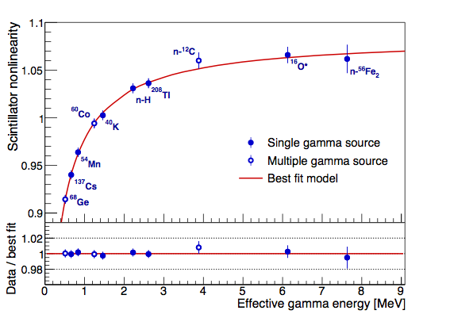
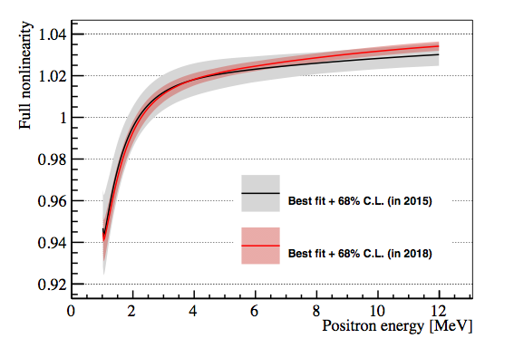
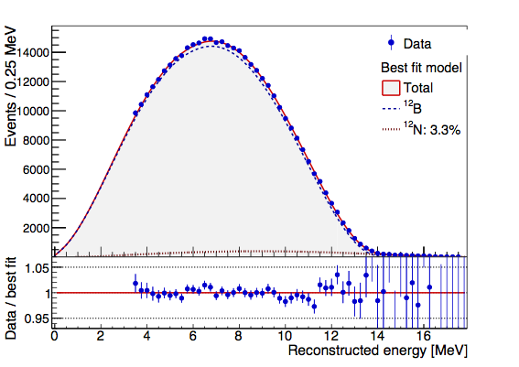
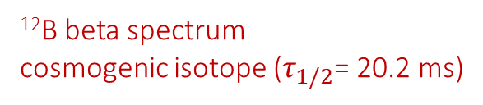
Improved Energy Response Model
The model is built based on various gamma peaks and the continuous ¹²B spectrum
Gamma calibration
Validated with low energy β+γ spectra from ²¹²Bi and ²¹⁴Bi
Uncertainty reduced to be ~0.5% from previous ~1.0%
Energy model
¹²B beta spectrum
cosmogenic isotope ($τ_{1/2}$= 20.2 ms)

Slide 12
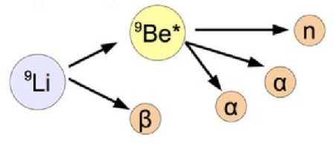
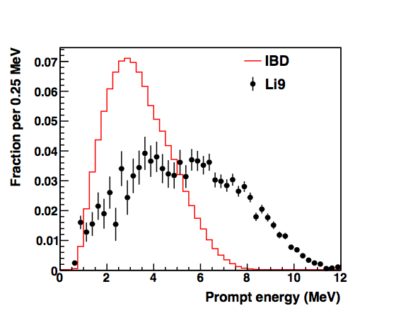
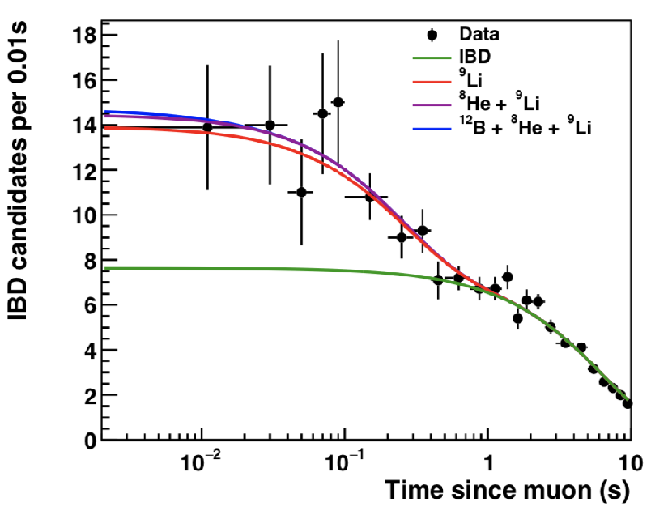
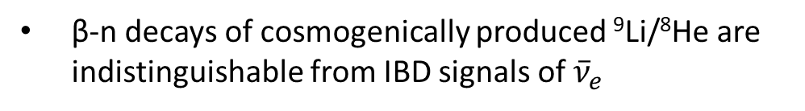
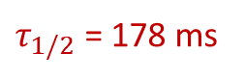
Improved ⁹Li/⁸He and SNF Uncertainty
$τ_{1/2}$ = 178 ms
β-n decays of cosmogenically produced ⁹Li/⁸He are indistinguishable from IBD signals of ${\overline{ν}}_{e}$
Now can take advantage of very large statistics:
Apply a large Eprompt cut to enhance the ⁹Li/⁸He fraction
Fit the time-since-last-muon distribution
(spectra normalized to area)
⁹Li/⁸He uncertainty in near ADs reduced from 50% to 30%
Also, a review of the spent nuclear fuel (SNF) history with power plant reduced its uncertainty from 100% to 30% (SNF=0.3% of total rate)

Slide 13
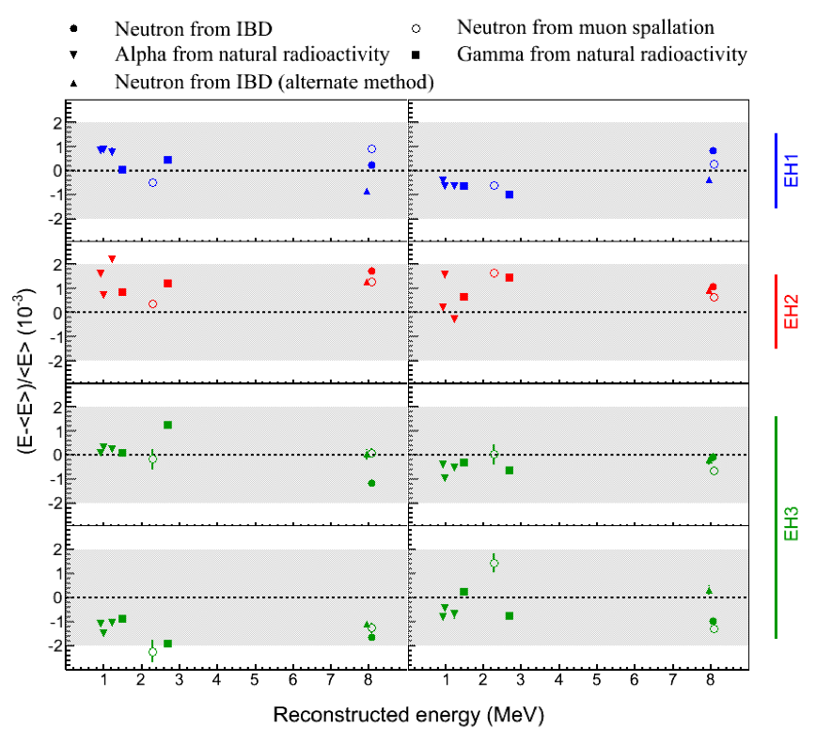
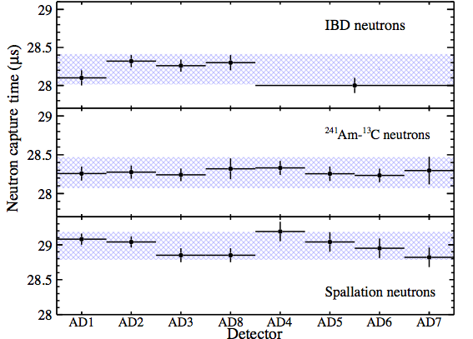
Relative Detection Efficiency
The relative detection efficiency uncertainty and the relative energy scale uncertainty are the dominant systematics for θ13 and |Δm²ee|:
Relative Gd capture fraction uncertainty < 0.10%
Relative energy scale uncertainty < 0.2%
Achieve a relative detection efficiency uncertainty of 0.13%

Slide 14
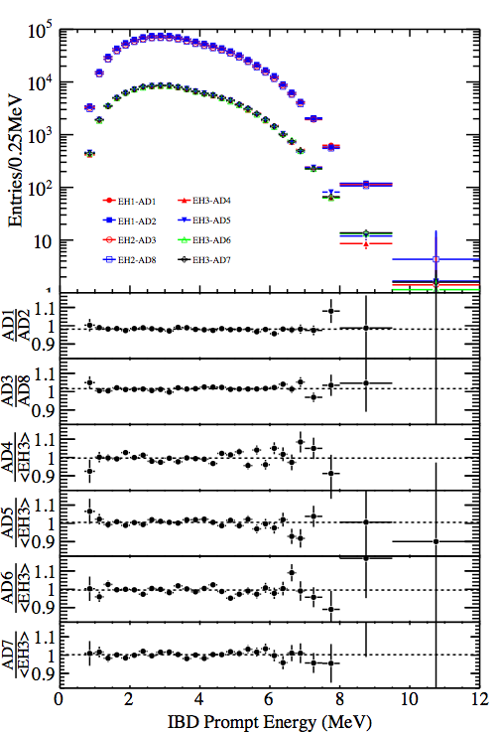
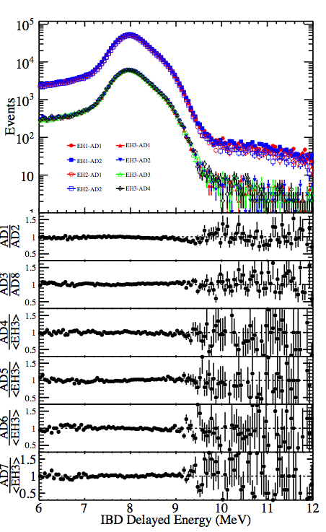
Side-by-side Spectral Comparison
Prompt Spectra
Delayed Spectra

Slide 15
IBD Candidates vs. Real Time

Slide 16
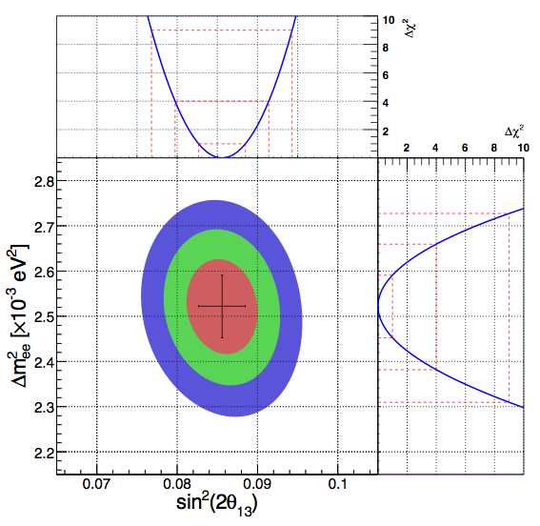
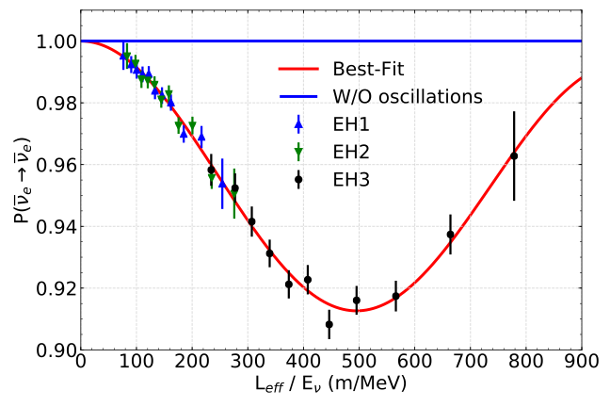
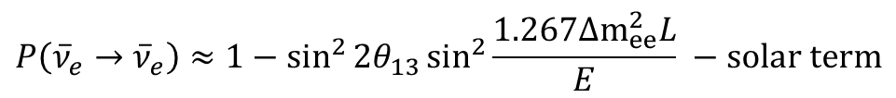
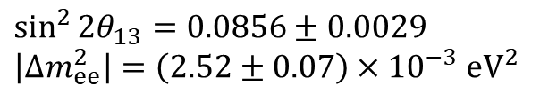
Oscillation Results with 1958 Days
Measure sin²2θ13 and |Δm²ee| to 3.4% and 2.8% respectively
$$P\left({\overline{ν}}_{e}→{\overline{ν}}_{e}\right)≈1−\sin^{2}{2θ_{13}}\sin^{2}{\frac{1.267Δm_{ee}^{2}L}{E} −solar term}$$
preliminary
preliminary
$$\sin^{2}{2θ_{13}}=0.0856±0.0029$$
$$\left|Δm_{ee}^{2}\right|=\left(2.52±0.07\right)×{10}^{−3} eV^{2}$$
The statistical uncertainty contributes about 60% (50%) of the total θ13 (Δm²ee) uncertainty.
Results are cross-checked by a few independent analyses

Slide 17
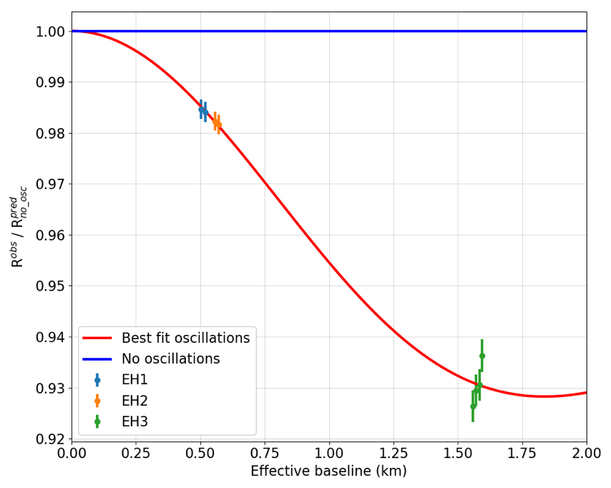

Distortion vs. 3$ν$ Oscillation
See a clear rate and shape distortion that fits well to the 3-neutrino hypothesis
preliminary
Rate-only
χ²/ndf=8.8/6
(p-value=0.19)
Rate+shape
χ²/ndf=148.0/154
preliminary

Slide 18
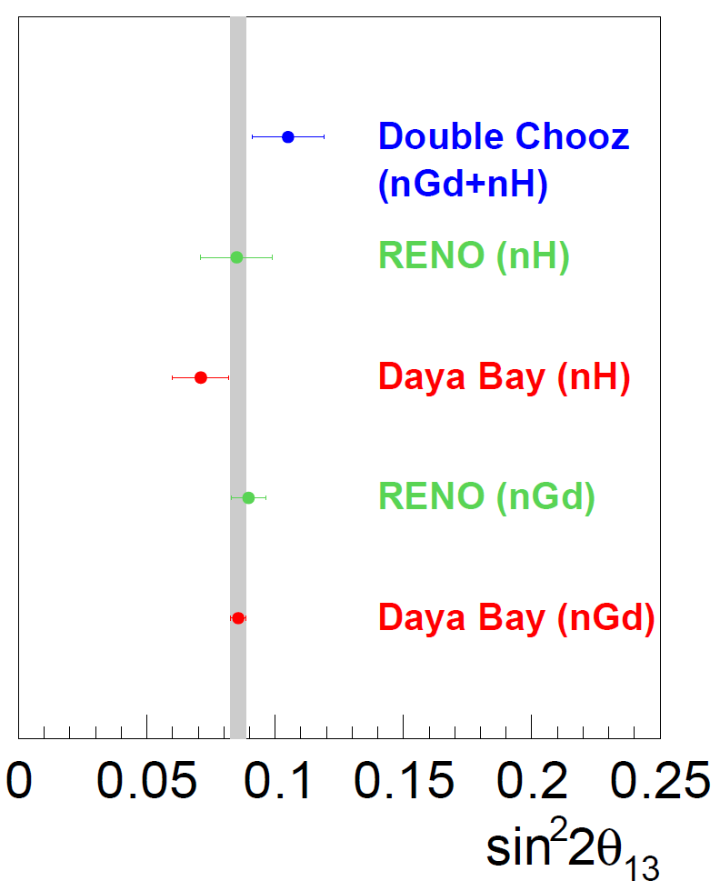
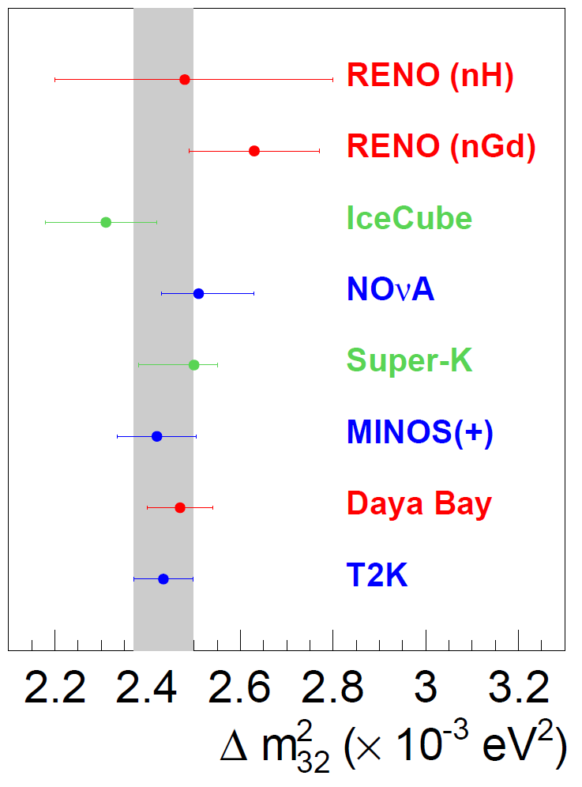
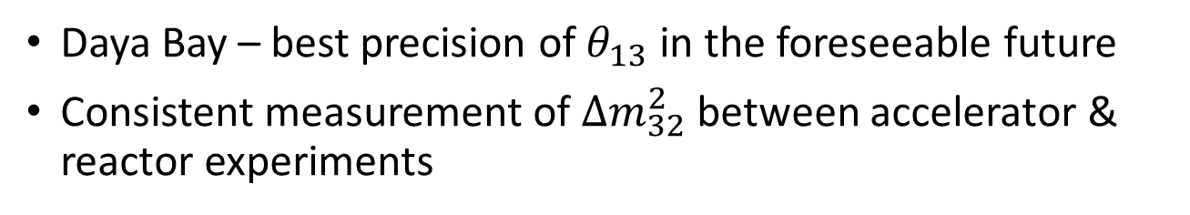
Global Comparison
results presented at Neutrino 2018 conference
Normal Ordering Assumed
Daya Bay – best precision of $θ_{13}$ in the foreseeable future
Consistent measurement of $Δm_{32}^{2}$ between accelerator & reactor experiments

Slide 19
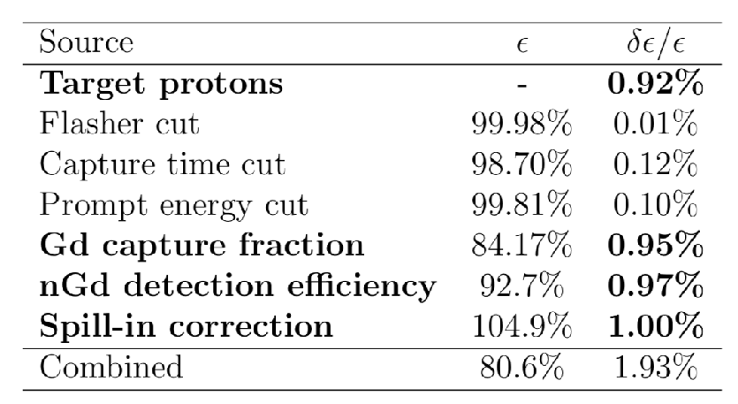
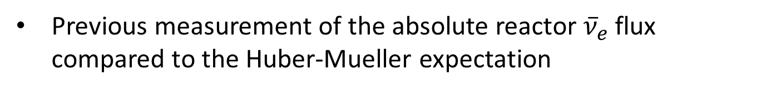
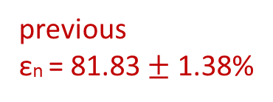
Absolute Antineutrino Flux
Previous measurement of the absolute reactor ${\overline{ν}}_{e}$flux compared to the Huber-Mueller expectation
systematics-dominated from absolute detection efficiency
Rdata/pred = 0.946 ± 0.020 (exp.)
New strategy: take new neutron calibration data and use it to constrain the “neutron detection efficiency” εn
Target: improve the εn uncertainty (x2)
previous efficiency values
previous
εn = 81.83 $±$ 1.38%

Slide 20
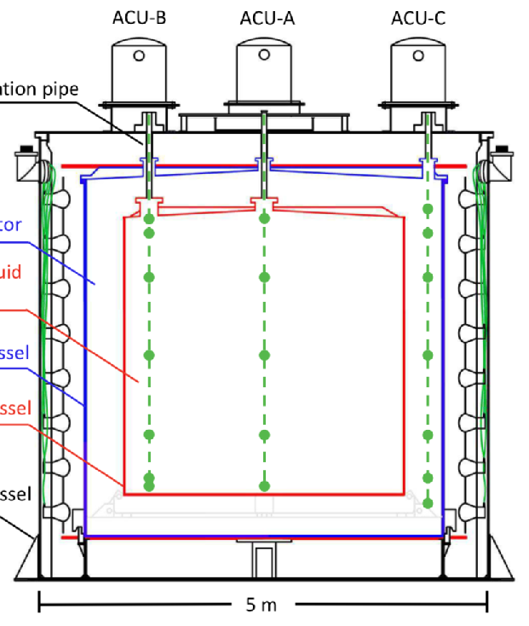
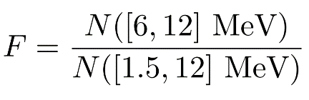
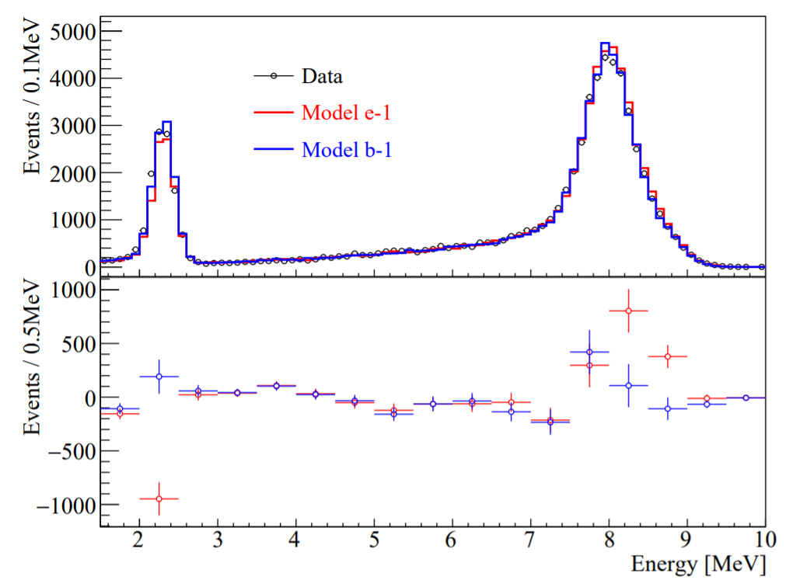
Neutron Calibration Campaign
Extensive neutron calibration campaign in early 2017
Deployed two neutron sources (²⁴¹Am-¹³C and ²⁴¹Am-⁹Be) along three vertical calibration axes
For each calibration point define a proxy for εn
²⁴¹Am-⁹Be
MC - Data
NIM A750, 19-37 (2014)
NIM A797, 260–264 (2015)

Slide 21
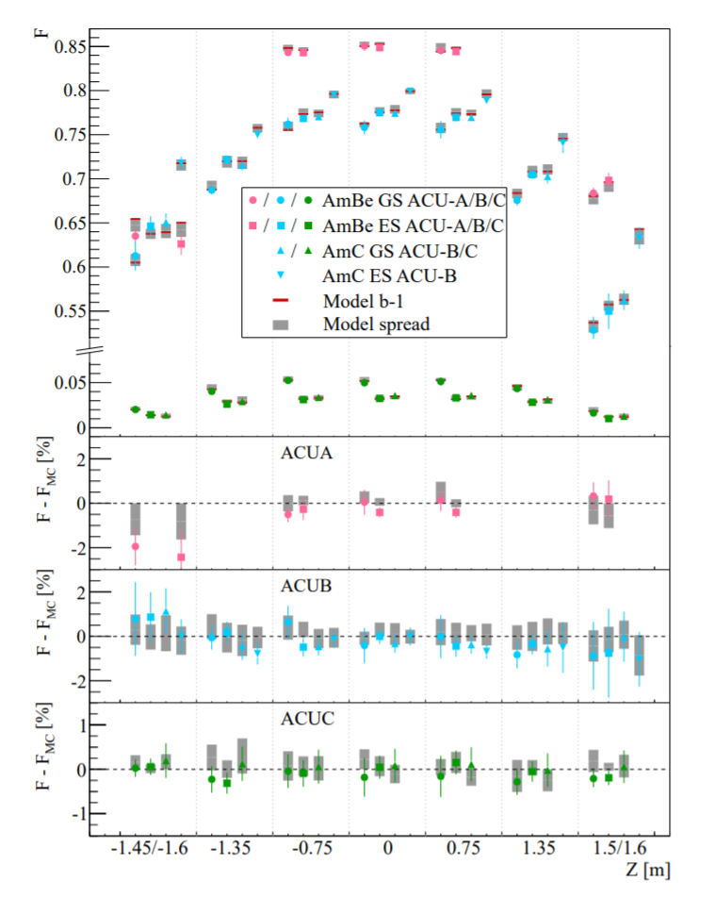

Neutron Calibration Campaign
preliminary
59 calibration points
AmC, AmBe in ground state and excited state (n+$γ$)
ACU-A, B, C
Vast change from F= 85% to 1%
Visited 20 different simulation models (5 neutron scattering $×$ 4 Gd capture gamma emission models)
Best model: sub-1% agreement with data
Residual differences mostly covered by model span (gray bar)

Slide 22



Improved Absolute Antineutrino Flux
The εn estimated by
MC simulation of best-fit model
A correction obtained from a linear regression analysis of the remaining data-MC difference
Uncertainty estimated with spread of models
$$ε_{n}=\left(81.48±0.60\right)\%$$
Target achieved: uncertainty improved by a factor of 2
results with 1230 days
preliminary
$R_{data/pred}$ (Huber-Mueller) $=0.952±0.014\left(exp.\right)$
$$σ_{f}=\left(5.91±0.09\right)×{10}^{−43}cm^{2}/fission$$
Flux model: Anna Hayes talk at N’18

Slide 23


Search for Time-Varying Antineutrino Signal
Performed a search for a time-varying ${\overline{ν}}_{e}$ signal over 704 calendar days
Motivated by Lorentz and CPT violation
No significant periodic signal for periods ranging from two hours to nearly two years
Unique layout of multiple directions and high-statistics
Simultaneous constraint of individual Standard-Model Extension (SME) coefficients
[PRD 80, 076007 (2009)]
preliminary
…
energy
direction

Slide 24

Cosmic-Ray Results from Daya Bay
Two cosmic-ray results from Daya Bay were released recently
Daya Bay’s points: D1, D2 and D3
Seasonal Variation of the Underground Cosmic Muon Flux
Observe a clear correlation between atmospheric temperature and variations in muon flux
JCAP 01 (2018) 001
Cosmogenic neutron production at Daya Bay
Measurement of neutron yield in LS. Important input for underground experiments.
Phys. Rev. D97, 052009 (2018)

Slide 25

Outlook
Daya Bay plans to run until 2020
Will achieve < 3% precision in $\sin^{2}2θ_{13}$
After the special calibration campaign in early 2017, EH1-AD1 has been used only for studying JUNO LS
Purification methods, different LS recipes, etc.
Studying energy scale and resolution
See JUNO talks from Xuefeng Ding and Yuekun Heng

Slide 26


Summary
Daya Bay has three new results this summer:
$$\sin^{2}{2θ_{13}}=0.0856±0.0029$$
$$\left|Δm_{ee}^{2}\right|=\left(2.52±0.07\right)×{10}^{−3} eV^{2}$$
$\left|Δm_{32}^{2}\right|=\left(2.47±0.07\right)×{10}^{−3} eV^{2}$ (NH)
new oscillation results with 1958 days
Articles in preparation
absolute reactor antineutrino flux (wrt Huber+Mueller)
with 1230 days
$$R_{data/pred}=0.952±0.014\left(exp.\right)$$
Set limits on the Lorentz and CPT violation under SME framework with a time-varying search
We also have many other recent results in other areas
We encourage you to look at the Daya Bay poster from Shengchao Li

Slide 27
Backup

Slide 28

 | Physics analysis published date | Detector status
2011 | AD 1/2 comparison | 2 EH1 ADs start data taking in Aug. 2+1+3 ADs start data taking in Dec.
2012 | March, First 5$σ$ $θ_{13}$, rate only, 55d | Calibration campaign in Jun. 2+2+4 ADs start data taking in Oct.
2013 | Improved $θ_{13}$ (9$σ$), rate only, 139d
2014 | Spectral analysis ($θ_{13}$ and $Δm^{2}$), 217d nH rate analysis, 217d Sterile neutrino, 217d
2015 | Full 8AD oscillation analysis, 621d | AD1 Flash-ADC upgrade in Dec.
2016 | Reactor flux & spectrum, 217d Improved nH, 621d Improved sterile nu, 621d Combined sterile with MINOS, 621d
2017 | Long reactor paper, 621d Long osc. paper, 1230d Fuel evolution, 1230d | Calibration campaign in Jan. AD1 taken out for LS study in Jan.
2018 | Muon flux variation Cosmogenic neutron production Long osc. Paper, 1958d (in preparation) New reactor flux, 1230d (in preparation) Time-varying antineutrino signal (in preparation)

Slide 29


Other Results
Finally, there are also other older results:
Evolution of the Reactor Antineutrino Flux and Spectrum
Phys. Rev. Lett. 182, 251801 (2017)
Independent measurement of θ13 via neutron capture on hydrogen
Phys. Rev. D93, 072011 (2016)
Improved search for a sterile neutrino (with Bugey-3 + MINOS)
Phys. Rev. Lett. 117, 151802 (2016)
Phys. Rev. Lett. 117, 151801 (2016)
Search for neutrino decoherence
Eur. Phys. J. C77, 606 (2017)

Slide 30

Near/Far Ratio
100% cancellation of flux uncertainty with one reactor, one near and one far detector
Double Chooz
~88% suppression of systematic uncertainties
RENO
~77%
Daya Bay
~95%
Statement (~80% suppression) in arXiv:1501.00356 regarding DYB is incorrect

Slide 31


Precision on Oscillation Parameters
Plan to run till 2020: uncertainties of $\sin^{2}{2θ_{13}}$ below 3%

Slide 32

Oscillation Results
Summary of oscillation results with 1958 days:
$$\sin^{2}{2θ_{13}}=0.0856±0.0029$$
$$\left|Δm_{ee}^{2}\right|=\left(2.52±0.07\right)×{10}^{−3} eV^{2}$$
$\left|Δm_{32}^{2}\right|=\left(2.47±0.07\right)×{10}^{−3} eV^{2}$ (NH)
$\left|Δm_{32}^{2}\right|=\left(−2.57±0.07\right)×{10}^{−3} eV^{2}$ (IH)
results with 1958 days

Slide 33



Effective Mass Splitting
Full oscillation probability:
$$P_{{\overline{ν}}_{e}→{\overline{ν}}_{e}}=1−\sin^{2}2θ_{13}\left(\cos^{2}θ_{12}\sin^{2}\frac{Δm_{31}^{2}L}{4E}+\sin^{2}θ_{12}\sin^{2}\frac{Δm_{32}^{2}L}{4E}\right)−\cos^{4}θ_{13}\sin^{2}{2θ}_{12}\sin^{2}\frac{Δm_{21}^{2}L}{4E}$$
Effective oscillation probability:
Advantages: independent of mass hierarchy and solar oscillation parametes
$$P_{{\overline{ν}}_{e}→{\overline{ν}}_{e}}=1−\sin^{2}2θ_{13}\sin^{2}\frac{1.267Δm_{ee}^{2}L}{E}−\cos^{4}θ_{13}\sin^{2}{2θ}_{12}\sin^{2}\frac{Δm_{21}^{2}L}{4E}$$
For Daya Bay’s L/E values, the full formula becomes:
$$P_{{\overline{ν}}_{e}→{\overline{ν}}_{e}}=1−4s_{13}^{2}c_{13}^{2}\left[\frac{1−\cos\left(2Δ_{32}±φ\right)}{2}\right]−\left(solar term\right)$$
$=1−\sin^{2}2θ_{13}\sin^{2}(Δ_{32 }±φ/2)−(solar term)$
$$Δ_{x}=Δm_{x}^{2}\frac{L}{4E}$$
where:
Comparing this expression with the effective one we conclude:
$$\left|Δm_{ee}^{2}\right|=\left|Δm_{32}^{2}\right|±\left(φ×\frac{4E}{L}\right) /2$$
$=\left|Δm_{32}^{2}\right|±\left(5.17×{10}^{−5}\right) {eV}^{2}$
The fit is always done with the full oscillation probability.

Slide 34

Spectra

Slide 35


Energy Response Stability
⁶⁰Co calibration method
spn-nGd calibration method

Slide 36

Side-by-side comparison

Slide 37


Absolute Reactor Antineutrino Flux
Cross-check: delayed energy spectrum of LS+GdLS IBD events compared to the best model. The ratio F is consistent to within 0.1% between the two
20 models at a single source location point (ACU B, z=0m)

Slide 38

Search for a Sidereal Modulation
We searched for a sidereal time modulation in the context of the Standard Model Extension (SME):
preliminary
Relationship between the so-called sidereal amplitudes and the individual SME coefficients is quite complex:
For example:
energy
direction
Daya Bay’s high-statistics and unique configuration with multiple neutrino directions allowed to disentangle the energy and direction dependence in these expressions for the first time

